Slide 1
A physics-based strategy for choosing initial iterate
for solving drift-diffusion equations✩

Slide 2
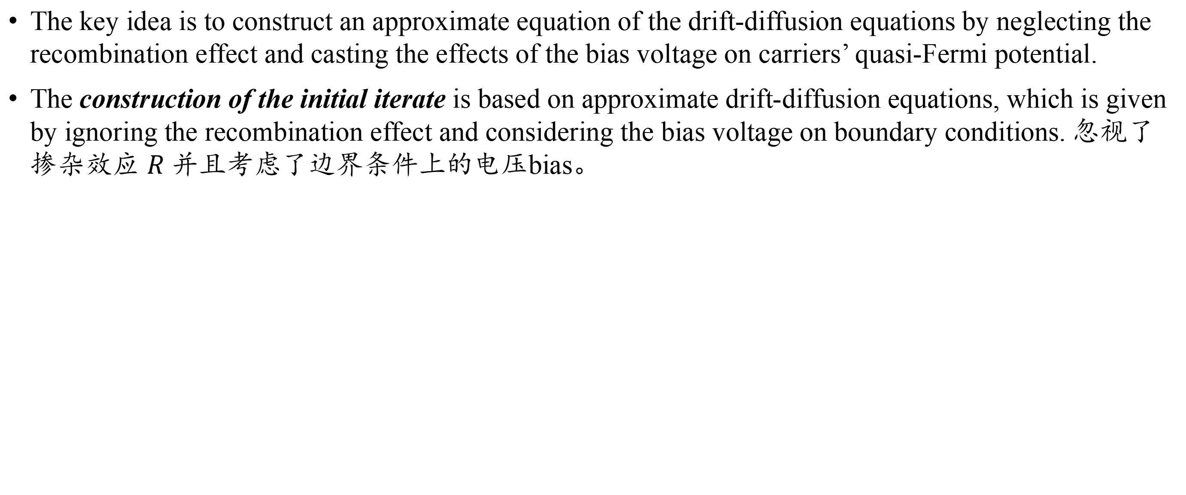
A physics-based strategy for choosing initial iterate for solving drift-diffusion equations
The key idea is to construct an approximate equation of the drift-diffusion equations by neglecting the recombination effect and casting the effects of the bias voltage on carriers’ quasi-Fermi potential.
The construction of the initial iterate is based on approximate drift-diffusion equations, which is given by ignoring the recombination effect and considering the bias voltage on boundary conditions. 忽视了掺杂效应 $R$ 并且考虑了边界条件上的电压bias。

Slide 3

A physics-based strategy for choosing initial iterate for solving drift-diffusion equations
Considering the double-carrier case, the governing equations of the driftdiffusion models are as follows:
with the boundary conditions:
𝜓 is the potential;
𝑛 denotes the electron concentration;
𝑝 denotes the hole concentration;
$N_{D}$ denote the donor concentration
$N_{A}$ denote the acceptor concentration
$J_{n}=J_{n}(n,ψ)$ denotes the electron current density
$J_{p}=J_{p}\left(p,ψ\right)$ denotes the hole current density
𝑅 = 𝑅(𝑛, 𝑝) denotes the carrier recombination rate
𝜀 is the permittivity of the material 介电常数

Slide 4
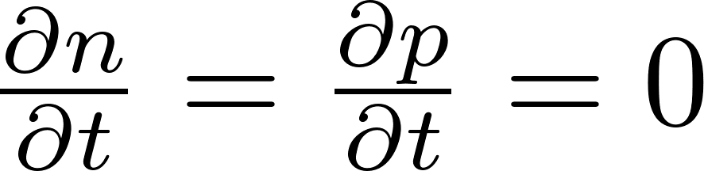
A physics-based strategy for choosing initial iterate for solving drift-diffusion equations
，得到一个稳态的方程：
How to set Dirichlet boundary conditions?
Adopt ohmic contact boundary conditions (corresponding to Dirichlet boundary conditions)：
Notes:
引入了欧姆接触边界条件；对于三个要求解的n,p,\psi变量。

Slide 5
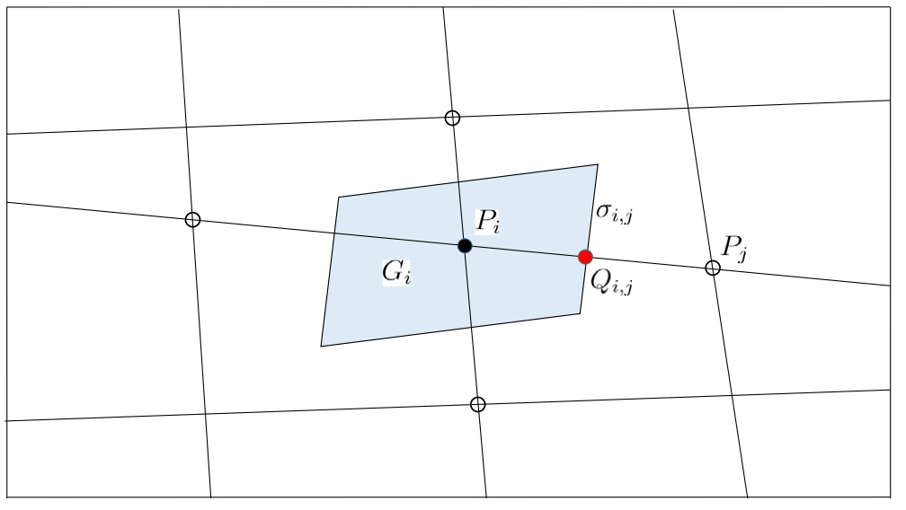
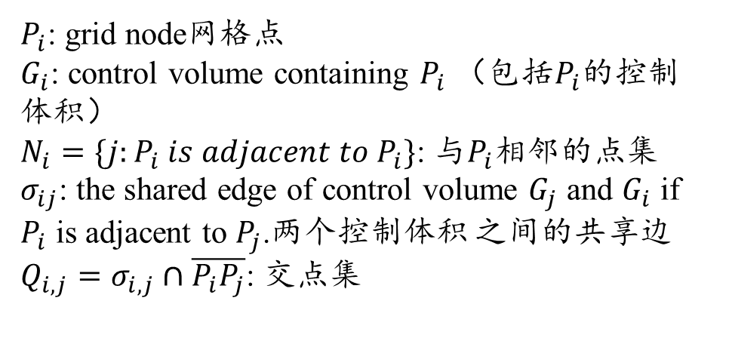
A physics-based strategy for choosing initial iterate for solving drift-diffusion equations
$P_{i}$: grid node网格点
$G_{i}$: control volume containing $P_{i}$ （包括$P_{i}$的控制体积）
$N_{i}=\{j:P_{i} is adjacent to P_{i}\}$: 与$P_{i}$相邻的点集
$σ_{ij}$: the shared edge of control volume $G_{j}$ and $G_{i}$ if $P_{i}$ is adjacent to $P_{j}$.两个控制体积 之间的共享边
$Q_{i,j}=σ_{i,j}∩\overline{P_{i}P_{j}}$: 交点集

Slide 6
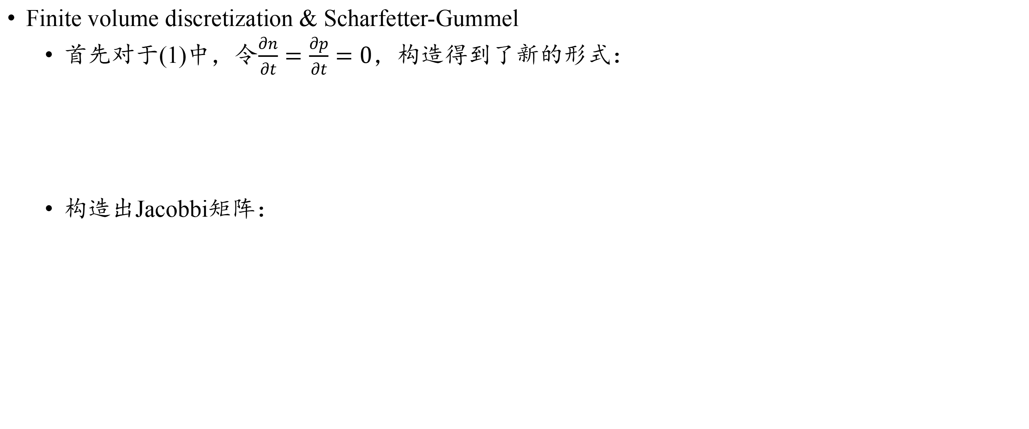
A physics-based strategy for choosing initial iterate for solving drift-diffusion equations: Finite volume discretization & Scharfetter-Gummel
Finite volume discretization & Scharfetter-Gummel
首先对于(1)中，令$\frac{∂n}{∂t}=\frac{∂p}{∂t}=0$，构造得到了新的形式：
构造出Jacobbi矩阵：
Notes:
The emphasis for the spatial discretization will be devoted to the convective effect of the current densities $J_{n}$ and $J_{p}$.
对空间离散化的重点将放在电流密度 𝐽𝑛 和 𝐽𝑝 的对流效应上。
In the finite volume method, the flux on the surface of the cell need to be constructed, and the Scharfetter-Gummel (SG) scheme is commonly used to construct the flux.
在有限体积法中，需要构建单元表面的通量，通常使用 Scharfetter-Gummel (SG) 方案来构建 通量。

Slide 7
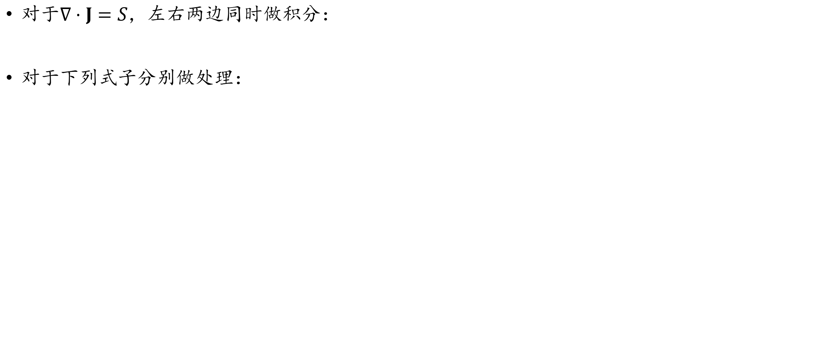
A physics-based strategy for choosing initial iterate for solving drift-diffusion equations: Finite volume discretization & Scharfetter-Gummel
对于$∇⋅J=S，$左右两边同时做积分：
对于下列式子分别做处理：
the nonlinear residuals
Notes:
the flux 𝜀∇𝜓 can be approximated by the difference at the midpoint of the edge 𝑃𝑖𝑃𝑗 （理解成中心差分法）
该种数值格式的应用具有一定的局限性，比如是在steady state情况才可以使用（两个偏微分等于0）。

Slide 8
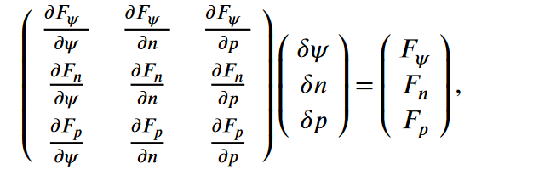
A physics-based strategy for choosing initial iterate for solving drift-diffusion equations: Nonlinear Iteration method非线性迭代方法
Newton’s Iteration Method
对一些非线性的项做了变换处理：
得到了牛顿迭代法的格式：

Slide 9
A physics-based strategy for choosing initial iterate for solving drift-diffusion equations: Nonlinear Iteration method非线性迭代方法
Newton’s Iteration Method
Disadvantage:
The computational cost for the Jacobian matrix of the drift-diffusion equations is expensive. If Jacobian-free Newton-Krylov (JFNK) method is used, some preconditioner should be constructed, and consequently, some computations about the Jacobian matrix may be concerned.
要进行矩阵预处理
Second, the Jacobian matrix is poor due to different properties of the different equations and the multi-scale character of the whole system.
Jacobian矩阵的性质差
Finally, in the traditional numerical simulation process, the numerical solution at the previous voltage is often used as the initial iterate for solving the equations with the current bias voltage. Since the convergence of Newton method is sensitive to the initial iterate, this will lead to a restriction on the step size of the bias voltage.

Slide 10
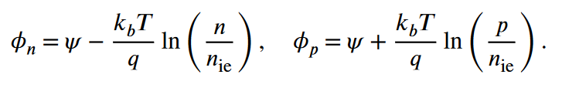
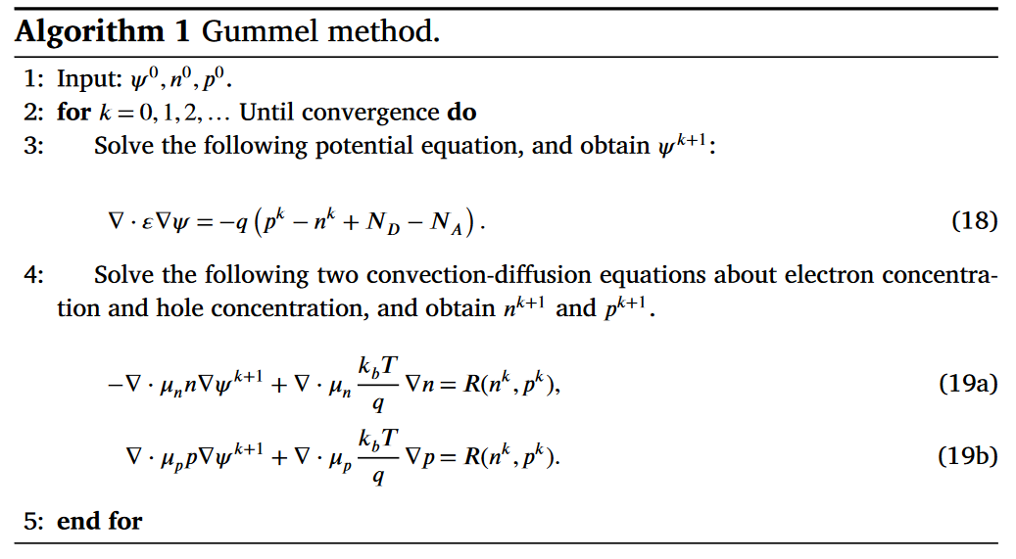

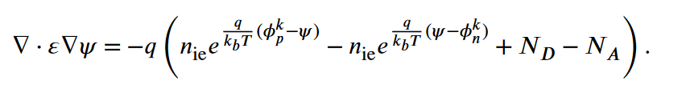


A physics-based strategy for choosing initial iterate for solving drift-diffusion equations: Nonlinear Iteration method非线性迭代方法
Gummel Method
Fix $n=n^{k}$ and $p=p^{k}$ and solve the
equation to obtain $ψ^{k+1}$.
Fix $ψ^{k+1}$ to obtain $n^{k+1}$ and $p^{k+1}$.
Improved Gummel method
$φ_{n}$ is the quasi-Fermi potential of electron carrier, and $φ_{p}$ is the quasi-Fermi potential of hole carrier:
代入方程
对于Possion方程先用Newton法进行了解耦处理
Linear system
Notes:
在algorithm 1中，鉴于载流子浓度固定，电势的泊松方程成为线性系统，比较容易求解(Since the carrier concentration is fixed, the Poisson equation for the potential is a linear system, which is relatively easy to be solved.)；
​ 然而，载流子浓度和电势之间存在固有的指数关系，因此对于固定载流子浓度的泊松方程进行线性化往往会导致 Gummel 迭代发散。（参照论文《AN APPROXIMATE NEWTON METHOD FOR THE SOLUTION OF THE BASIC SEMICONDUCTOR DEVICE EQUATIONS*》中的定义： $n=e^{\psi}u,p=e^{-\psi}v$ ）
​ 引入准费米能级（quasi-Fermi potential）的概念，$𝜙_𝑛$ is the quasi-Fermi potential of electron carrier, and $𝜙_𝑝$ is the quasi-Fermi potential of hole

Slide 11
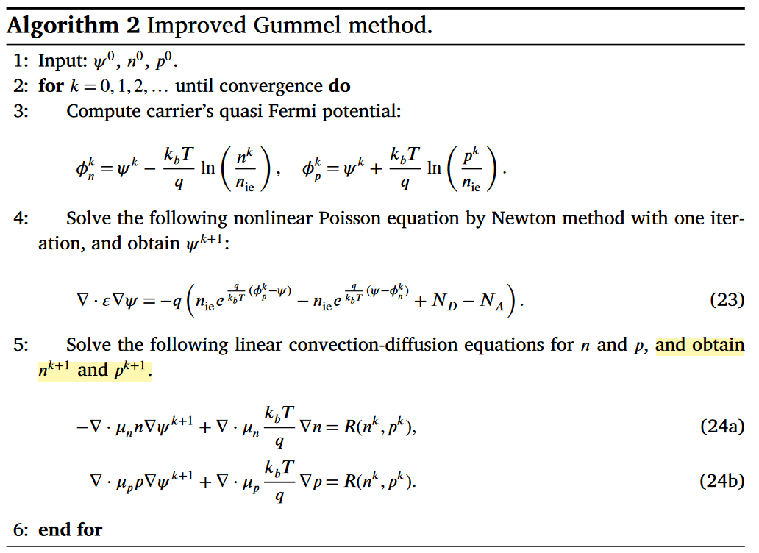
A physics-based strategy for choosing initial iterate for solving drift-diffusion equations: Nonlinear Iteration method非线性迭代方法
Gummel Method
Improved Gummel Method

Slide 12
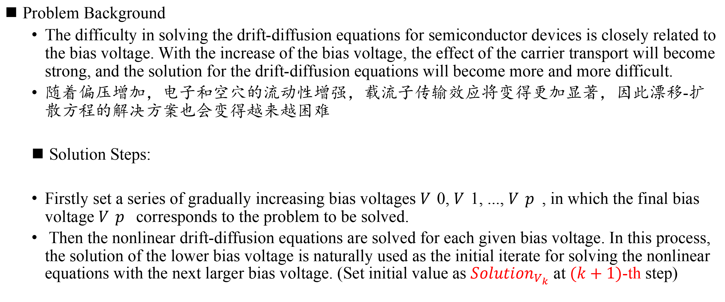
A physics-based strategy for choosing initial iterate for solving drift-diffusion equations: Physics-based initial iterate
Problem Background
The difficulty in solving the drift-diffusion equations for semiconductor devices is closely related to the bias voltage. With the increase of the bias voltage, the effect of the carrier transport will become strong, and the solution for the drift-diffusion equations will become more and more difficult.
随着偏压增加，电子和空穴的流动性增强，载流子传输效应将变得更加显著，因此漂移-扩散方程的解决方案也会变得越来越困难
Solution Steps:
Firstly set a series of gradually increasing bias voltages 𝑉0, 𝑉1, ..., 𝑉𝑝, in which the final bias voltage 𝑉𝑝 corresponds to the problem to be solved.
Then the nonlinear drift-diffusion equations are solved for each given bias voltage. In this process, the solution of the lower bias voltage is naturally used as the initial iterate for solving the nonlinear equations with the next larger bias voltage. (Set initial value as $Solution_{V_{k}}$ at $(k+1)$-th step)
Notes:
首先设定一系列逐渐增加的偏置电压 𝑉0, 𝑉1, ..., 𝑉𝑝，其中最终的偏置电压 𝑉𝑝 对应需要解决的问题；
在这个过程中，较低偏置电压的解自然地被用作解决下一个更大偏置电压的非线性方程的初始迭代。

Slide 13
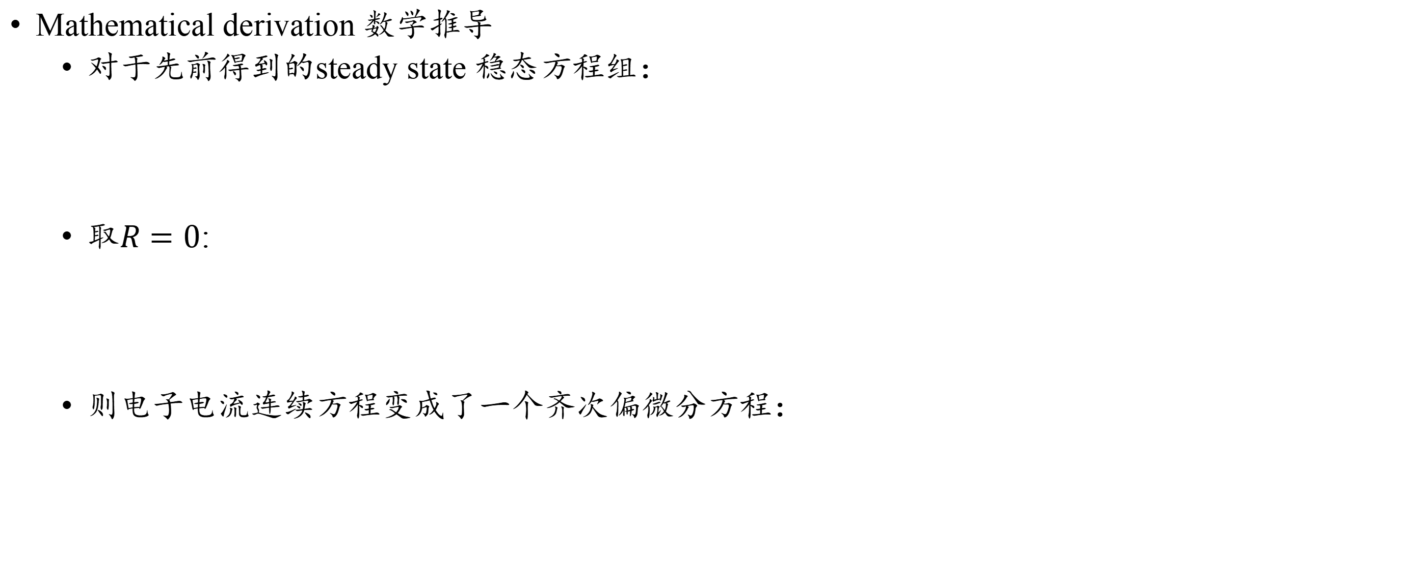
A physics-based strategy for choosing initial iterate for solving drift-diffusion equations: Physics-based initial iterate
Mathematical derivation 数学推导
对于先前得到的steady state 稳态方程组：
取$R=0$:
则电子电流连续方程变成了一个齐次偏微分方程：
Notes:
则电子电流连续方程变成了一个齐次偏微分方程，取一阶的情况，那么散度就可以表示成一个方向的导数：

Slide 14
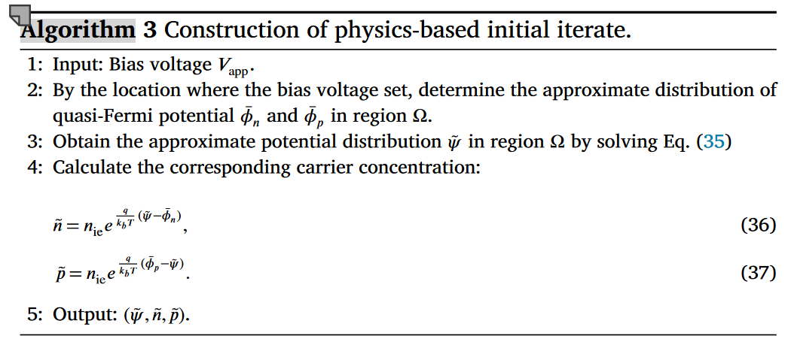
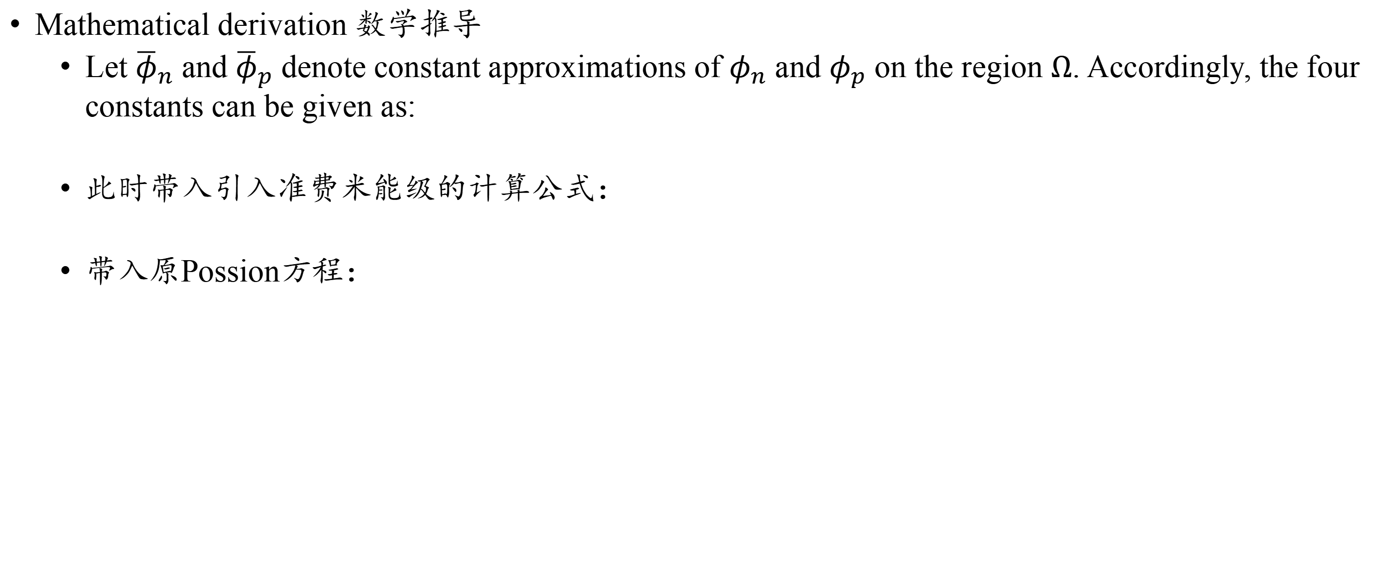
A physics-based strategy for choosing initial iterate for solving drift-diffusion equations: Physics-based initial iterate
Mathematical derivation 数学推导
Let ${\overline{φ}}_{n}$ and ${\overline{φ}}_{p}$ denote constant approximations of $φ_{n}$ and $φ_{p}$ on the region $Ω$. Accordingly, the four constants can be given as:
此时带入引入准费米能级的计算公式：
带入原Possion方程：
Notes:
则电子电流连续方程变成了一个齐次偏微分方程，取一阶的情况，那么散度就可以表示成一个方向的导数：

Slide 15
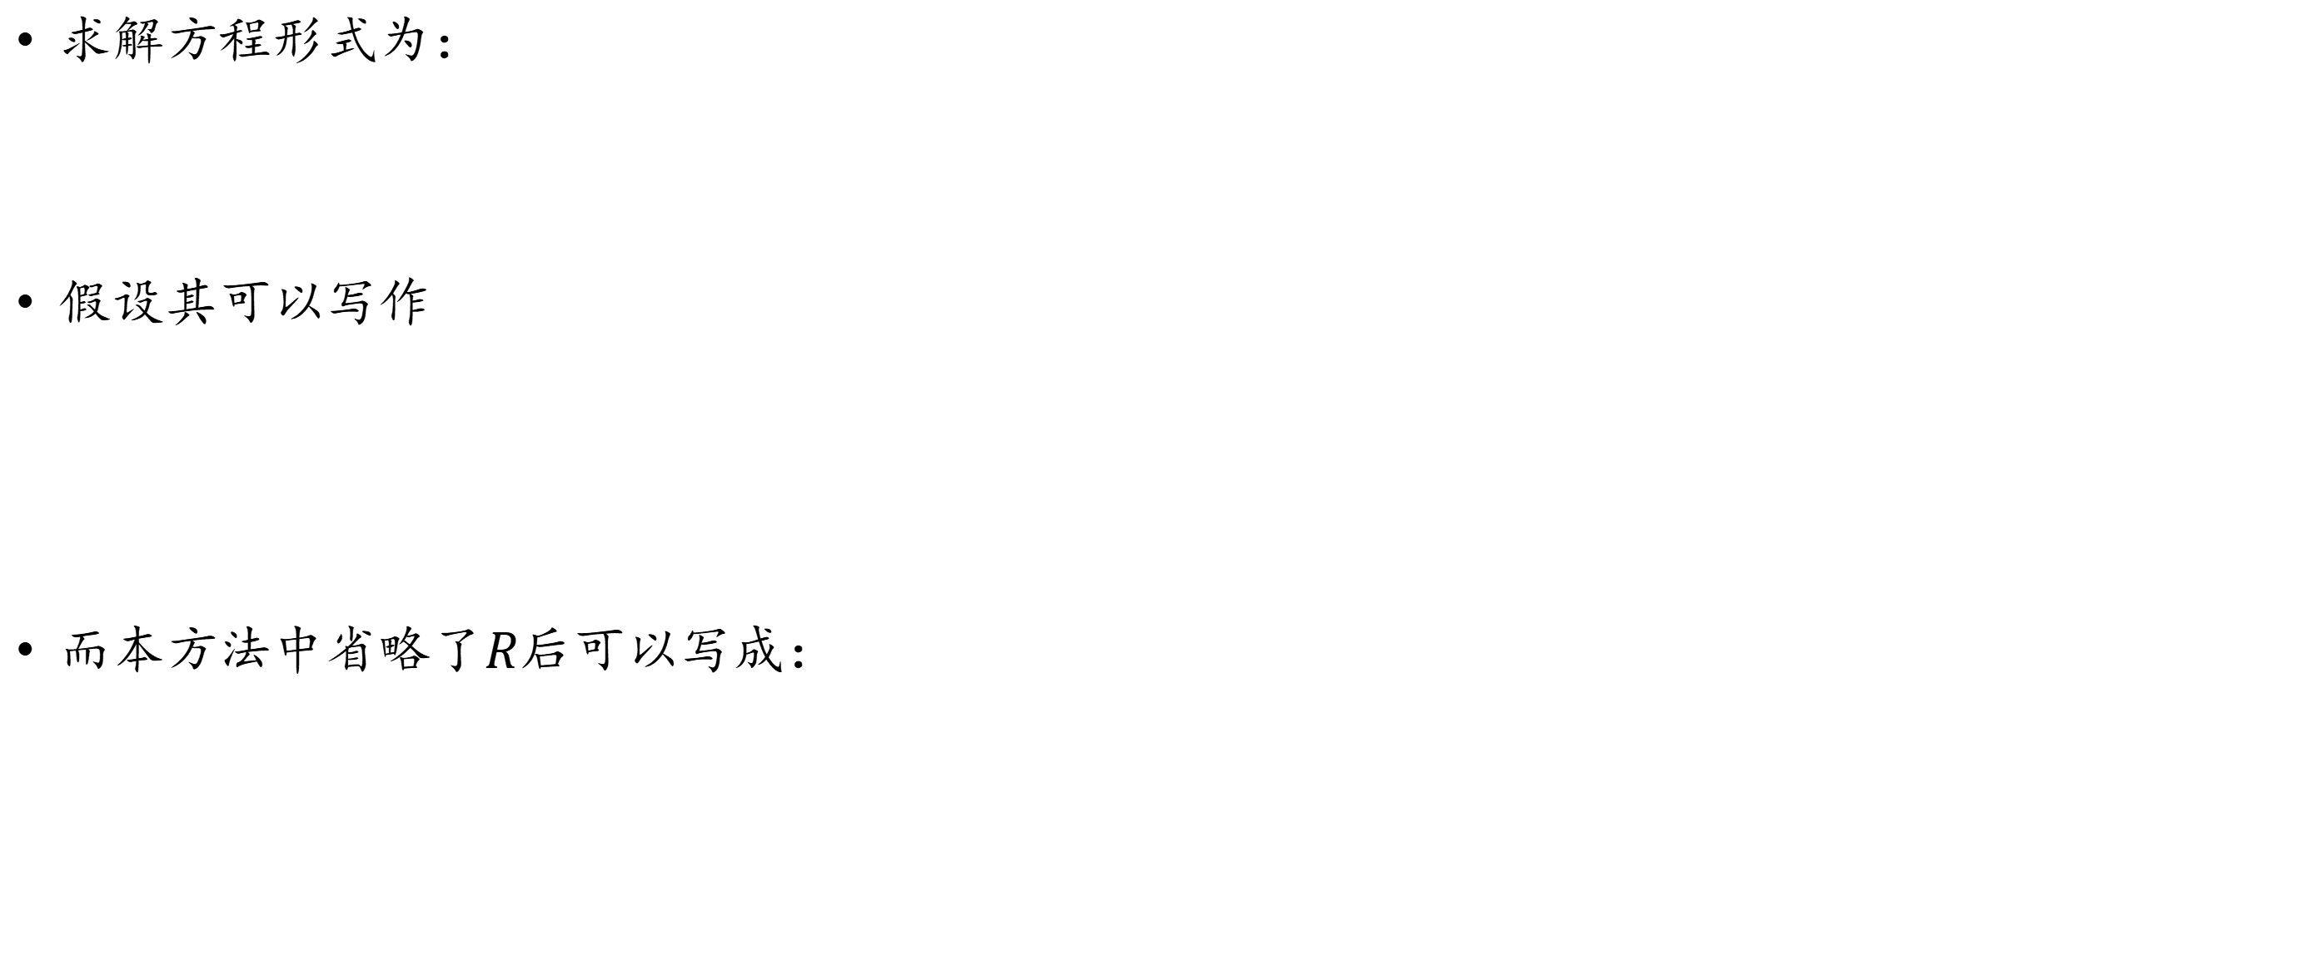
A physics-based strategy for choosing initial iterate for solving drift-diffusion equations: Error Estimate
求解方程形式为：
假设其可以写作
而本方法中省略了$R$后可以写成：
Notes:
The distance between the solutions of the two nonlinear systems is controlled by the recombination term, the boundary conditions, and the nonlinear equations’ feature at the solution。两个非线性系统解之间的距离受到复合项、边界条件以及解的非线性特性的控制。

Slide 16
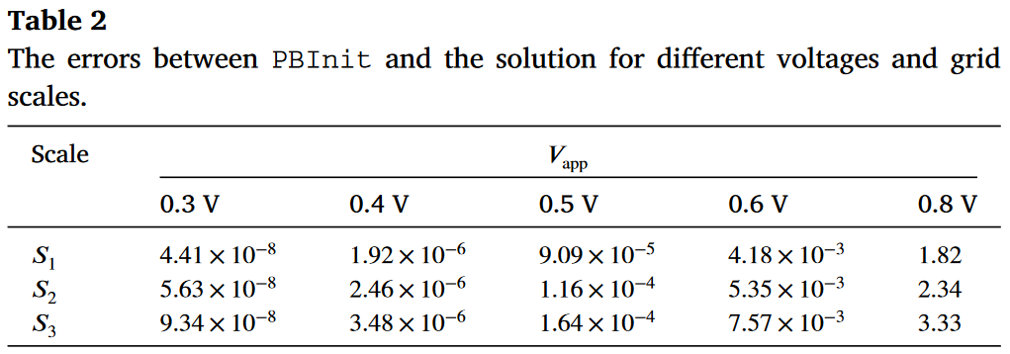
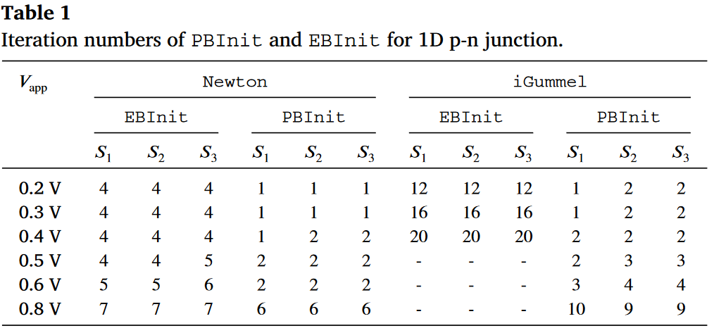
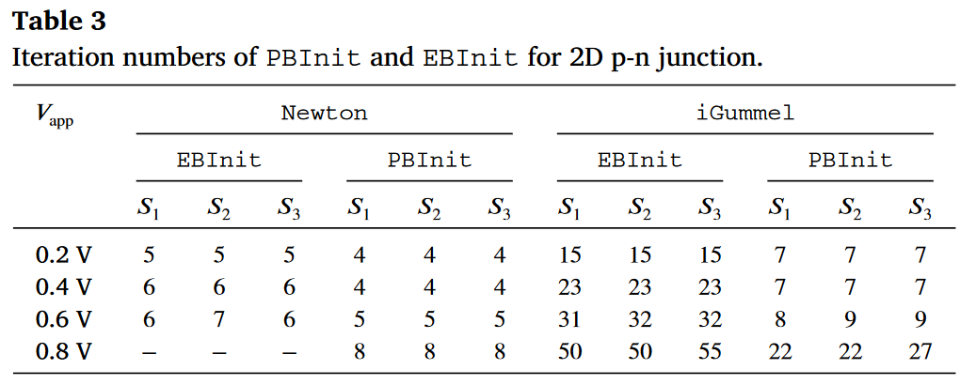

A physics-based strategy for choosing initial iterate for solving drift-diffusion equations: Numerical Examples
Compare results between the EBInit(the equilibrium-based initial iterate) and the PBInit(the physics-based initial iterate).
The errors between PBInit and the solution for different voltages($S_{1}$ = 625, $S_{2}$ = 1024, and $S_{3}$ = 2048) and grid scales.
Iteration numbers of PBInit and EBInit for 2D p-n junction

